Slide 1
PIPELINE DEMO
From match data to Key States and graphs
cd C:\Users\Srinivasan\grf-prototype
# analysis tools:
.venv-analysis\Scripts\python
# simulator (GRF):
.venv\Scripts\python
Each step with the command that runs it, the data it produces, and a picture of the result
Two Python environments: one for the simulator, one for the data and models
4 real Bundesliga matches · 4 simulated matches
Notes:
The whole demo is a flow of seven steps. Every step slide has the command at the top, a sample of the real data below it, and the columns explained. Commands are run from the project folder.

Slide 2
The flow: seven steps from raw data to a model
0
1
2
3
4
5
6
Raw data
Common format
Key States
Sequences
Types
Graphs
GNN
download_real
save_meta
convert_real
export_tracking
extract_keystates
find_sequences
describe_sequences
cluster_sequences
build_graphs
plot_graph
train_gnn
summarise_gnn
Two sources enter at step 1. The real match is converted into the layout the simulator already writes, so steps 2 to 6 are the same code for both. Real matches are the reference; simulated matches are the system we check against it.
Notes:
Walk left to right. Steps 0 and 1 prepare the data, 2 to 4 find Key States, sequences and types, 5 builds graphs, 6 trains a model on the graphs.

Slide 3
Step 0 · Raw real data
.venv-analysis\Scripts\python scripts\download_real.py J03WN1 # tracking + events
.venv-analysis\Scripts\python scripts\save_meta.py J03WN1 # teams, players, pitch size, score
Tracking file: one row per frame, 25 per second (J03WMX, first frames)
frame_id | ball_state | ball_owning_team_id | ball_x | ball_y | 0002DR_x | 0002DR_y | 0002DR_s
10000 | alive | DFL-CLU-00000G | 0.502 | 0.502 | 0.055 | 0.497 | 0
10001 | alive | DFL-CLU-00000G | 0.496 | 0.503 | 0.055 | 0.497 | 2.21
10002 | alive | DFL-CLU-00000G | 0.491 | 0.503 | 0.055 | 0.497 | 2.35
Events file
event_type | timestamp | team_id | player_id | set_piece_type | result
PASS | 0:00:00 | DFL-CLU-00000G | DFL-OBJ-0027G6 | KICK_OFF | COMPLETE
x and y run from 0 to 1, not metres. Each player has its own columns (_x, _y, _d direction, _s speed), 137 columns in all. Teams and positions come from the players file: 0002DR is the Bayern keeper.
Notes:
Raw data has no team information in the tracking file, which is why the players file and metadata are needed.

Slide 4
Step 1 · Common format
# real match (analysis environment)
.venv-analysis\Scripts\python scripts\convert_real.py J03WN1
# simulated match (GRF environment)
.venv\Scripts\python scripts\export_tracking.py --steps 3000 --seed 4 --out data\simulated\match_004.csv
Real (J03WMX.csv.gz)
frame | time_s | team | player_id | role | x_m | y_m | vx_ms | ball_x_m | ball_owner | game_mode
1 | 0.1 | away | 0 | GK | 99.15 | 33.82 | -0.8 | 54.04 | away | normal
1 | 0.1 | away | 1 | CB | 68.36 | 33.11 | -1.9 | 54.04 | away | normal
1 | 0.1 | home | 0 | GK | 5.24 | 33.74 | 1.1 | 54.04 | away | normal
Simulated (match_001.csv)
frame | time_s | team | player_id | role | x_m | y_m | vx_ms | ball_x_m | ball_owner | game_mode
1 | 0.1 | home | 0 | GK | -0.58 | 34 | 0 | 52.5 | none | normal
1 | 0.1 | home | 1 | RM | 52.5 | 32.48 | 0 | 52.5 | none | normal
1 | 0.1 | home | 2 | CF | 52.59 | 35.73 | 1.44 | 52.5 | none | normal
Metres on a 105 × 68 pitch at 10 frames per second; home always attacks toward x = 105. player_id is a slot inside the team (0 = goalkeeper). Checks: each converted match reproduces its final score and has 11 players per team.
Notes:
The simulator already writes this layout; the real match is converted into it. That is what makes one set of analysis code work for both.

Slide 5
Step 2 · Key States
.venv-analysis\Scripts\python scripts\extract_keystates.py --csv data\real\processed\J03WMX.csv.gz --theta 3
D = 0.4 · d_abs + 0.4 · d_rel + 0.2 · d_ball the first frame where D ≥ 3 m becomes the next Key State
Real: J03WMX_adaptive_ks.csv
Result
Real: 3,550 of 58,387 frames (6%); longest gap 26 s
Simulated: 368 of 3,000 frames (12%); longest gap 3.6 s
ks_id | time_s | gap_s | d_abs | d_rel | d_ball | d_ks | frame
1 | 0.7 | 0.7 | 1.5 | 1.3 | 10.34 | 3.19 | 7
2 | 1.9 | 1.2 | 2.97 | 2.26 | 5.42 | 3.18 | 19
3 | 2.4 | 0.5 | 1.64 | 0.85 | 12.14 | 3.43 | 24
Simulated: match_001_adaptive_ks.csv
ks_id | time_s | gap_s | d_abs | d_rel | d_ball | d_ks | frame
1 | 0.9 | 0.9 | 2.82 | 3.29 | 4.5 | 3.34 | 9
2 | 1.4 | 0.5 | 2.8 | 3.23 | 5.94 | 3.6 | 14
3 | 2.1 | 0.7 | 4.05 | 3.87 | 0.32 | 3.23 | 21
Notes:
Check the arithmetic on the first real row: 0.4 times 1.50 plus 0.4 times 1.30 plus 0.2 times 10.34 is 3.19, just above the 3 m threshold.

Slide 6
Step 3 · Geometry features and sequence boundaries
$all = (Get-ChildItem data\real\processed\J03W*.csv.gz, data\simulated\match_00?.csv).FullName
.venv-analysis\Scripts\python scripts\find_sequences.py --csv $all
Geometry numbers per Key State (J03WMX_ks_features.csv)
ks_id | time_s | gap_s | ball_x_m | ball_speed | mean_speed | home_width | away_width | home_depth | away_depth | seq_id
449 | 599.9 | 1.1 | 74.11 | 6.46 | 2.95 | 44.88 | 56.02 | 29.34 | 34.24 | 34
450 | 601.5 | 1.6 | 78.63 | 4.04 | 1.74 | 42.85 | 55.95 | 32.59 | 38.53 | 34
Sequences between boundaries (J03WMX_sequences.csv)
How a boundary is found
Average the geometry numbers over the previous 5 s and the next 5 s; where they differ clearly (a peak above one shared threshold), a new sequence starts. No possession, dead-ball flag or events are used.
seq_id | start_time_s | end_time_s | duration_s
32 | 542.5 | 554.5 | 12
33 | 554.5 | 584.5 | 30
34 | 584.5 | 717.5 | 133
Notes:
All eight matches run together because they share one scale and one threshold, which keeps sequence counts comparable between real and simulated matches.

Slide 7
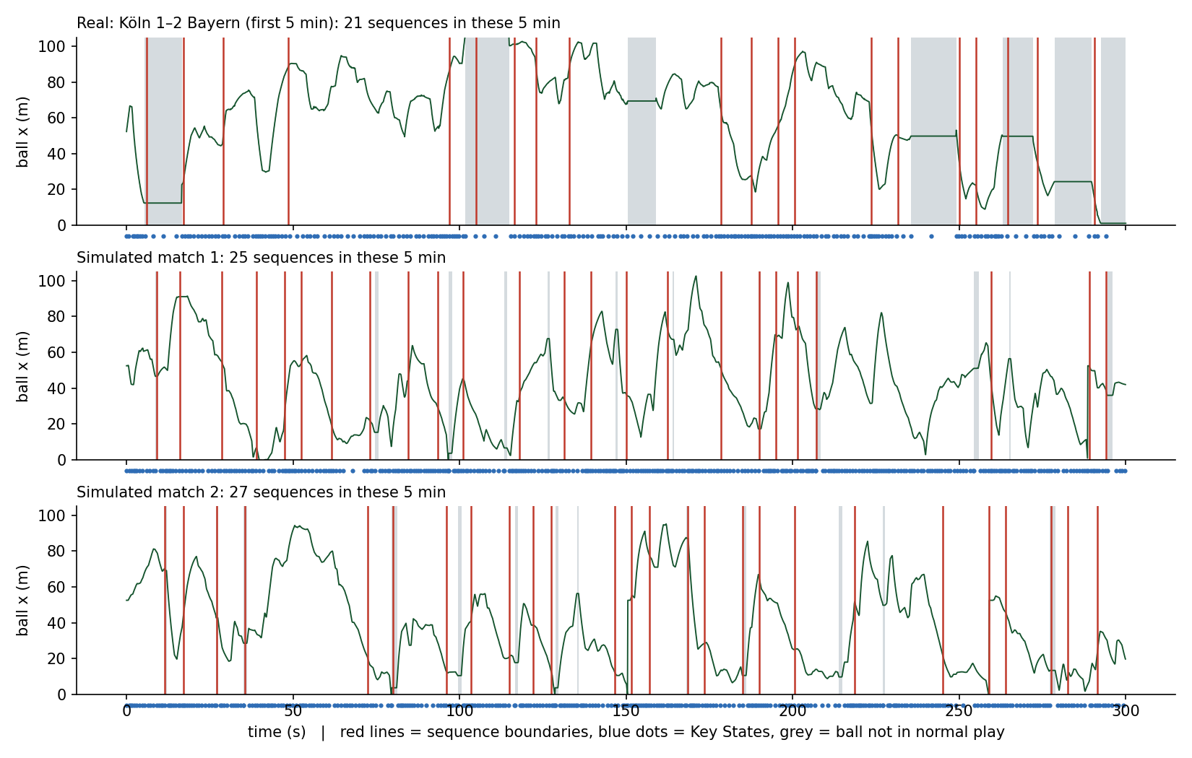
Step 3 · Describe the boundaries with football events
.venv-analysis\Scripts\python scripts\describe_sequences.py --csv data\real\processed\J03WMX.csv.gz `
--events data\real\raw\J03WMX_events.csv.gz
.venv-analysis\Scripts\python scripts\plot_sequences.py
J03WMX_boundary_events.csv
time_s | explained | football_description
5 | True | possession → home; ball out; ball dead
17 | True | play restarts
28 | False | (no event within 2 s)
Result, 4 real matches
39% of boundaries have a strong football event nearby (random times: 21%). 47% of stoppages and restarts are caught (random: 18%).
Notes:
Red lines in the picture are boundaries, grey shading is the ball not in normal play. The shading is for description only; the boundaries never used it.

Slide 8
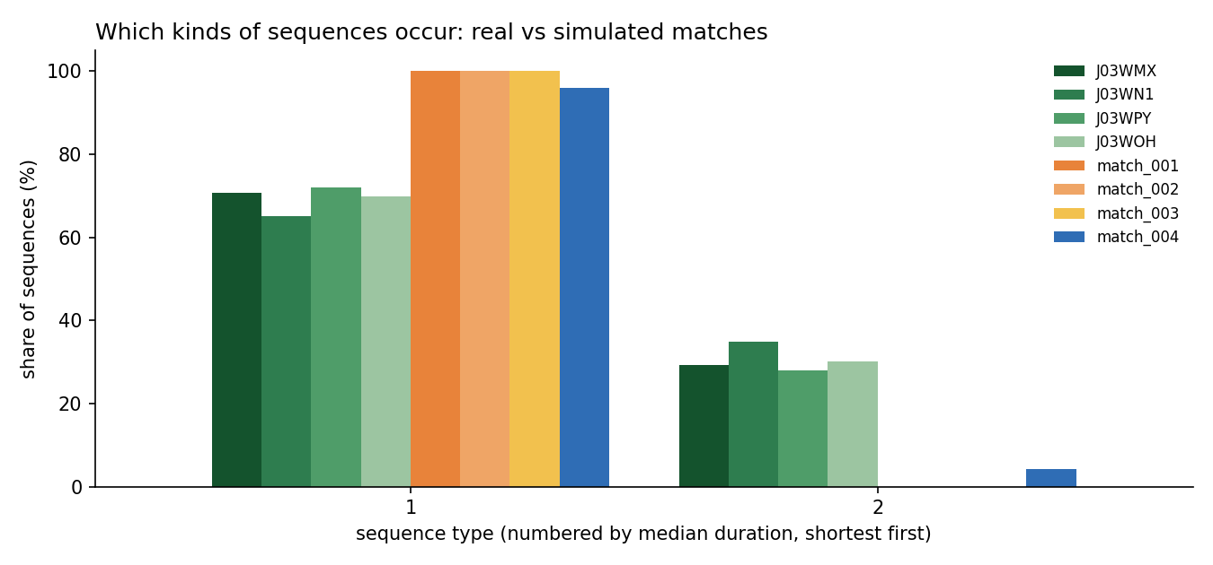
Step 4 · Types of sequence
.venv-analysis\Scripts\python scripts\cluster_sequences.py
J03WMX_sequence_types.csv, two rows
seq | dur_s | n_ks | speed | dead_% | type
86 | 5.5 | 5 | 3.8 | 0 | 1
117 | 52.5 | 14 | 1.1 | 85 | 2
Type 1: open play
real 65–72%, simulated 96–100%
Type 2: stoppage
real 28–35%, simulated 0–4%
Only two types gave the same grouping in every real match (agreement 0.90 each, 0.99 leave-one-out).
Notes:
Types are found from geometry only. Football descriptions are attached afterwards to read them.

Slide 9
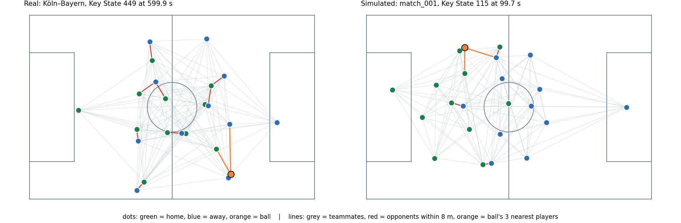
Step 5 · Every Key State becomes a graph
.venv-analysis\Scripts\python scripts\build_graphs.py --csv $all # same $all as step 3
.venv-analysis\Scripts\python scripts\plot_graph.py
Key State 449, 599.9 s
23 nodes: 11 home, 11 away, the ball
110 teammate links
10 opponent links (within 8 m)
3 ball links (nearest players)
slot | team | role | x_m | y_m | vx | vy | dist_ball | dx_prev | dy_prev
5 | home | AM | 64.6 | 35 | -0.4 | -3 | 27.5 | -0.8 | -2.9
21 | away | LB | 73.2 | 8 | 4.8 | 0.1 | 1.5 | 4.3 | -0.9
22 | ball | - | 74.1 | 9.2 | 0 | 0 | 0 | 3.6 | -6.2
Notes:
Slots 0 to 10 are the home team, 11 to 21 the away team, 22 the ball. dx_prev and dy_prev are the movement since the previous Key State, which is the time information.

Slide 10
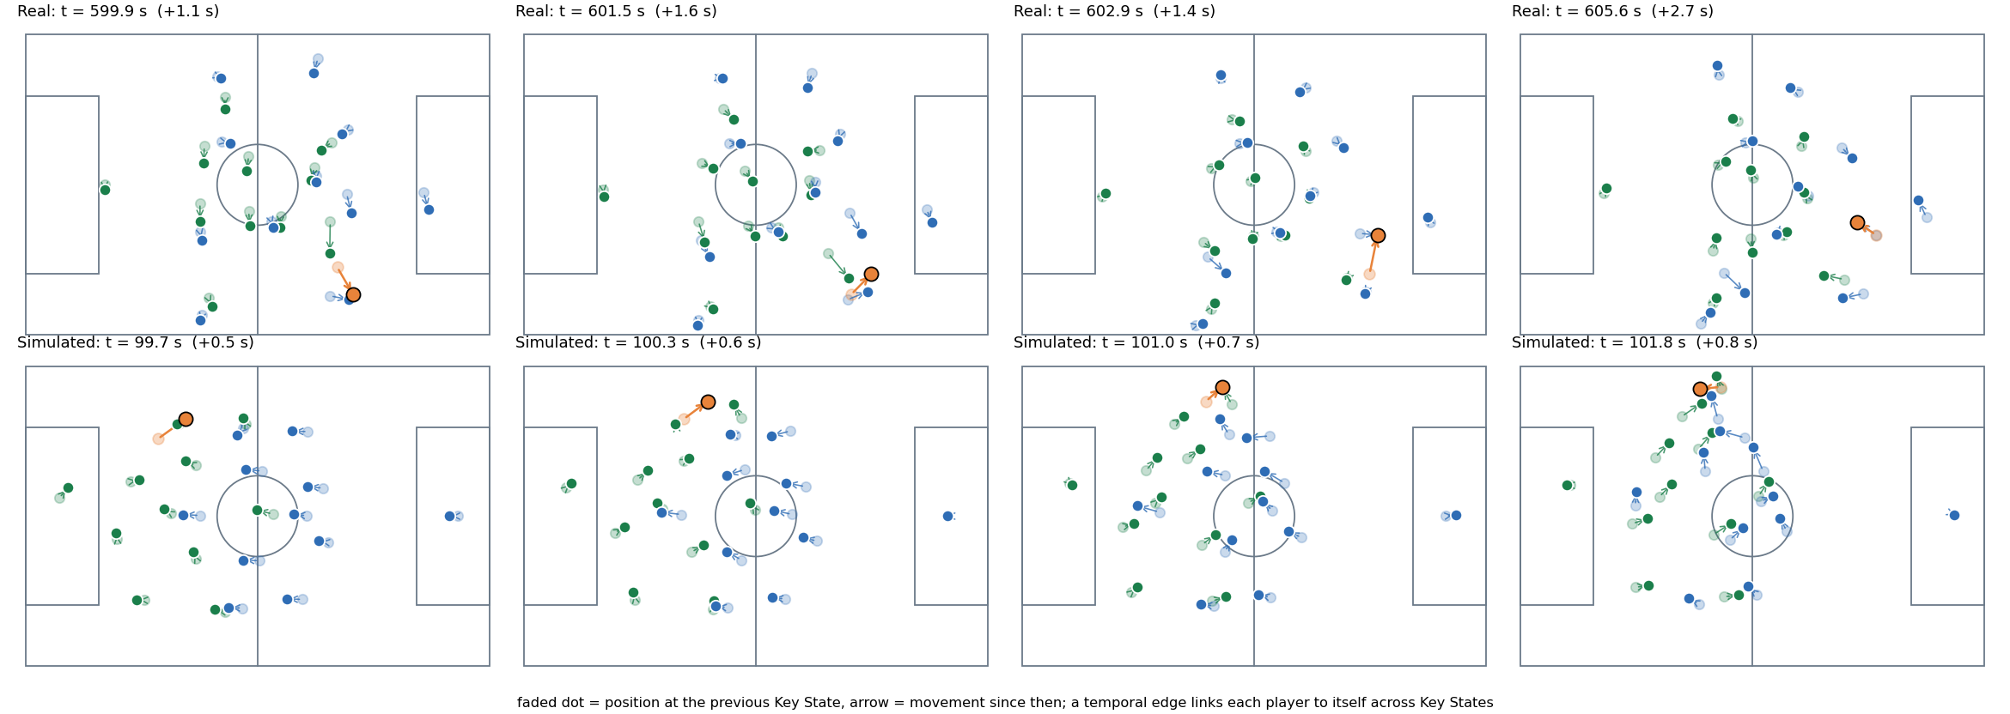
Step 5 · Time across Key States
What is stored
dxy_prev: movement since the previous Key State
gap_s: the time between them
seq_id: which sequence
Graph statistics: 4 real vs 4 simulated matches
Spatial structure matches; time behaviour does not: simulated players move about 2.3 times faster (median 3.4 vs 1.5 m/s).
Measure | Real | Simulated
Opponent links per graph | 11.5 – 13.5 | 11.4 – 13.2
Edge churn between Key States | 0.26 – 0.28 | 0.34 – 0.37
Implied player speed (m/s) | 2.2 – 2.4 | 5.2 – 8.1
Notes:
Faded dots are the previous Key State, arrows the movement. The simulator step is 0.1 s (physics 100 Hz, 10 steps per step), so the speed difference is real behaviour, not a labelling error.

Slide 11
Step 6 · Graph network (GNN)
.venv-analysis\Scripts\python scripts\train_gnn.py --holdout J03WOH --graphs radius --epochs 8
.venv-analysis\Scripts\python scripts\train_gnn.py --holdout none --epochs 12 --save-embeddings
Last 3 graphs
20 numbers per node + time gaps
Message passing
one rule per edge type, 2 rounds
GRU over time
reads each node's 3 states
Output
movement (dx, dy) to the next Key State
Mean error in metres on unseen matches (lower is better) · radius graphs
On real football the model beats both simple guesses (1.13 m vs 1.50 m and 2.94 m). On the simulator it only ties the velocity guess: simulated movement lacks the real patterns the model learned.
Match | Kind | Model | Nobody moves | Keep velocity
J03WOH | held-out real | 1.13 | 2.94 | 1.50
match_001 | simulated | 2.13 | 3.42 | 2.15
match_004 | simulated | 2.33 | 3.53 | 2.42
Notes:
Latest run: radius graphs, 8 epochs, held-out real match J03WOH. Model error 1.13 m vs 1.50 m for 'keep velocity' and 2.94 m for 'nobody moves'. On simulated matches the model ties the velocity guess (match_001: 2.13 vs 2.15 m; match_004: 2.33 vs 2.42 m). Caveat: one held-out real match and one seed.

Slide 12
Result · Radius graphs vs Delaunay graphs
Radius graph (our default)
Teammates: all 110 links. Opponents: players within 8 m, about 12 links. Ball: its 3 nearest players.
Mean error in metres, held-out matches (lower is better)
Delaunay graph (triangle mesh)
Each player links to the neighbours around them: about 25 to 27 team links and 29 to 31 opponent links (checked on 2 matches).
A tie. Real match: 1.13 m (radius) vs 1.17 m (Delaunay). Simulated average: 2.39 m for both. The radius graph stays the default. Caveat: one held-out real match and one seed; repeating on J03WMX (about 45 min) would confirm.
Notes:
Same model, same seed, same 8 epochs; only the graph edges change. Radius = fixed rules (all teammates, opponents within 8 m, 3 nearest to ball). Delaunay = triangle mesh on player positions, far fewer edges. Per simulated match radius/Delaunay: 2.13/2.13, 2.43/2.43, 2.67/2.68, 2.33/2.33. Conclusion is a tie on this test; it is one held-out match and one seed, so it is not proof that edge type never matters.

Slide 13
Run order: all commands in one place
Prepare the data (once per match)
Analyse (all matches together)
cd C:\Users\Srinivasan\grf-prototype
# real match (analysis env)
.venv-analysis\Scripts\python `
scripts\download_real.py J03WN1
.venv-analysis\Scripts\python `
scripts\save_meta.py J03WN1
.venv-analysis\Scripts\python `
scripts\convert_real.py J03WN1
# simulated match (GRF env)
.venv\Scripts\python `
scripts\export_tracking.py --steps 3000 `
--seed 4 --out data\simulated\match_004.csv
$all = (Get-ChildItem `
data\real\processed\J03W*.csv.gz, `
data\simulated\match_00?.csv).FullName
# then, each with .venv-analysis\Scripts\python:
scripts\extract_keystates.py --csv <file> --theta 3
scripts\find_sequences.py --csv $all
scripts\describe_sequences.py --csv <file>
scripts\cluster_sequences.py
scripts\build_graphs.py --csv $all
scripts\plot_sequences.py
scripts\plot_graph.py
scripts\train_gnn.py --holdout J03WOH `
--graphs radius --epochs 8 # or delaunay
scripts\summarise_gnn.py # radius vs delaunay
scripts\show_pipeline_data.py # prints sample rows
extract_keystates.py and describe_sequences.py run once per match; the others take all matches at once. train_gnn.py runs once per graph type, then summarise_gnn.py prints the comparison.
Notes:
This is the order to run things in. The two environments are never mixed: the simulator runs in .venv, everything else in .venv-analysis.

Slide 14
What is completed so far
Same code for both sources
Real matches
DFL / Sportec tracking, 4 matches used
1
2
3
4
5
Common format
metres, 105 x 68 pitch, 10 frames per second
Key States
frame kept when movement reaches 3 m (about 6% of real frames)
Sequences
5 s windows; 2 stable types: open play, stoppage
Graphs
23 nodes; radius and Delaunay edges; saved as .npz
GNN
message passing + GRU; predicts next movement
Simulated matches
Google Research Football, 4 matches
BUILT AND TESTED
BUILT AND TESTED
BUILT AND TESTED
BUILT AND TESTED
BUILT AND TESTED
DONE Result so far
PARTLY Tactical states
NEXT Still open
Real match: 1.13 m error vs 1.50 m (keep velocity) and 2.94 m (nobody moves).
Radius vs Delaunay graphs: a tie (1.13 vs 1.17 m).
Simulator only ties the velocity guess.
4 clusters of the GNN embeddings exist, but they mostly separate player speed.
No saved script yet.
Check the simulator time scale (3000 steps vs scoreboard clock).
Repeat the comparison on J03WMX.
Use the 3 unused DFL matches.
Confirm the Key State definition with the professor.
Notes:
Architecture of what exists today. Two sources enter the same pipeline: 4 real DFL/Sportec matches and 4 simulated GRF matches. Steps 1 to 5 are built and tested. The tactical-state clustering is only partly done (mostly separates speed, no script saved). Open items are the simulator time-scale check, a repeat of the graph comparison on a second held-out match, the remaining DFL matches, and confirming the Key State definition with the professor.

